Slide 1
CSE 260
Digital Logic Design
Combinational Circuit-3
BRAC University

Slide 2
Arithmetic Circuits: Comparator
Magnitude comparator: compares 2 values A and B, to see if A>B, A=B or A<B.
How do we compare two 4-bit values A (a₃a₂a₁a₀) and B (b₃b₂b₁b₀)?
If (a₃ > b₃) then A > B
If (a₃ < b₃) then A < B
If (a₃ = b₃) then if (a₂ > b₂) ….

Slide 3
Equality Comparator
XNOR
X Y Z
0 0 1
0 1 0
1 0 0
1 1 1
X
Z
Y
Z = !(X ⊕ Y)

Slide 4
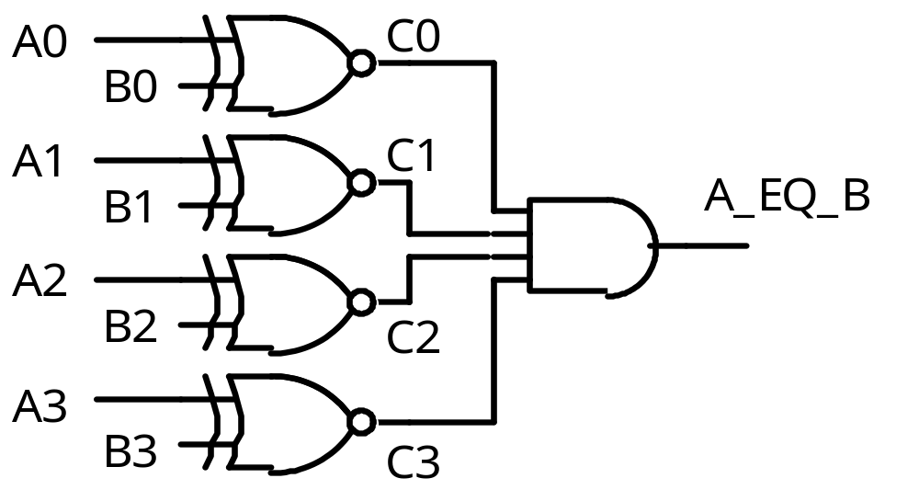
4-Bit Equality Comparator
FIELD A = [A0..3];
FIELD B = [B0..3];
FIELD C = [C0..3];

Slide 5
4-bit Equality Detector
A[3..0]
Equality
Detector
A_EQ_B
B[3..0]

Slide 6
4-bit Magnitude Comparator
A_LT_B
A[3..0]
Magnitude
Detector
A_EQ_B
B[3..0]
A_GT_B
Note: here EQ stands for ‘equal’, LT stands for ‘less than’ and GT stands for ‘greater than’.

Slide 7
Magnitude Comparator
How can we find A_GT_B?
How many rows would a truth table have?
2⁸ = 256!

Slide 8
Magnitude Comparator
Find A_GT_B
Because A3 > B3, which means
A=1 and B=0
i.e. A3 & !B3 = 1
If A = 1001 and
B = 0111
is A > B?
Why?
Therefore, one term in the
logic equation for A_GT_B is
A3 & !B3

Slide 9
Magnitude Comparator
A_GT_B = A3 & !B3
+ …..
Because A3 = B3 and
A2 > B2
i.e. C3 = 1 and
A2 & !B2 = 1
If A = 1101 and
B = 1011
is A > B?
Why?
Therefore, the next term in the
logic equation for A_GT_B is
C3 & A2 & !B2

Slide 10
Magnitude Comparator
A_GT_B = A3 & !B3
+ C3 & A2 & !B2
+ …..
Because A3 = B3 and
A2 = B2 and
A1 > B1
i.e. C3 = 1 and C2 = 1 and
A1 & !B1 = 1
If A = 1010 and
B = 1001
is A > B?
Why?
Therefore, the next term in the
logic equation for A_GT_B is
C3 & C2 & A1 & !B1

Slide 11
Magnitude Comparator
A_GT_B = A3 & !B3
+ C3 & A2 & !B2
+ C3 & C2 & A1 & !B1
+ …..
Because A3 = B3 and
A2 = B2 and
A1 = B1 and
A0 > B0
i.e. C3 = 1 and C2 = 1 and
C1 = 1 and A0 & !B0 = 1
If A = 1011 and
B = 1010
is A > B?
Why?
Therefore, the last term in the
logic equation for A_GT_B is
C3 & C2 & C1 & A0 & !B0

Slide 12
Magnitude Comparator
A_GT_B = A3 & !B3
+ C3 & A2 & !B2
+ C3 & C2 & A1 & !B1
+ C3 & C2 & C1 & A0 & !B0

Slide 13
Magnitude Comparator
Now Find A_LT_B
A_LT_B = !A3 & B3
+ C3 & !A2 & B2
+ C3 & C2 & !A1 & B1
+ C3 & C2 & C1 & !A0 & B0

Slide 14
Arithmetic Circuits: Comparator
Note: This is the circuit of Magnitude compar-ator!!!
All previous slides where for just understan-ding!
Let A = A₃A₂A₁A₀ , B = B₃B₂B₁B₀; x_{i} = A_{i}.B_{i} + A_{i}'.B_{i}'
A₃
x₃
A₃'.B₃
B₃
A₃.B₃'
A₃'.B₃ + x₃.A₂'.B₂
+ x₃.x₂.A₁'.B₁
+ x₃. x₂.x₁.A₀'.B₀
A₂
x₂
B₂
(A < B)
A₁
x₁
B₁
A₃.B₃' + x₃.A₂.B₂'
+ x₃.x₂.A₁.B₁'
+ x₃. x₂.x₁.A₀.B₀'
A₀
x₀
(A > B)
B₀
(A = B)
x₃. x₂.x₁.x₀

Slide 15
Important points
Note: We start by comparing digits in from MSB position. If those digits are equal, then we compare next 2 lower significant pairs of digits.
Same circuit of previous slide can be used for comparing relative magnitude of 2 BCD digits.

Slide 16
Arithmetic Circuits: Comparator
0
1
1
0
A₃
A₂
A₁
A₀
4-bit comp
1
0
1
0
B₃
B₂
B₁
B₀
(A < B)
1
0
0
(A > B)
(A = B)
Block diagram of a 4-bit magnitude comparator

